Slide 1


Impact of Medical Conditions Across USA
Notes:
Hello everyone, my name is Geetha Janapareddi pursuing Masters in Business Analytics with Data Science Specialization, and I am here to present my capstone project titled 'Impact of Medical Conditions Across USA.' This project aims to analyze how various medical conditions affect different regions, leveraging advanced business analytics techniques. Let's dive into the details.

Slide 2
Introduction
Project Title:
Analyzing the Impact of Medical Conditions Across Regions Using Research and Development Data
Description:
Overview of the project's aim to analyze the impact of medical conditions using comprehensive data.
Objectives:
1. Evaluate Incidence and Management.
2. Analyze Healthcare System Strain.
3. Identify Correlations.
4. Provide Data-Driven Recommendations.
Notes:
"In this slide, I'll give an overview of the project and its objectives. This project aims to analyze the impact of various medical conditions across different regions using comprehensive research and development data kaggle. I will leverage advanced business analytics techniques to gain a detailed understanding of how medical conditions vary by region and what this means for healthcare systems and policy-making.” Objectives: "I aim to evaluate the incidence and management of different medical conditions across various regions. For example, comparing how diabetes is managed in urban areas versus rural areas."
"I will analyze the strain on healthcare systems and resource allocation related to these medical conditions. For instance, assessing the capacity and workload of hospitals in regions with high rates of chronic illnesses."
"I will identify correlations between the prevalence of medical conditions and socioeconomic, demographic, and healthcare infrastructure factors. For example, exploring if there is a link between income levels and access to quality healthcare."
"Finally, I aim to provide data-driven recommendations for healthcare policy improvements and resource optimization, helping policymakers make informed decisions."

Slide 3
Problem Description
Variability in medical conditions across regions.
Impact on healthcare resources and delivery.
Need for data-driven policy recommendations.
Notes:
"This slide focuses on the key issues my project aims to address. First, there is significant variability in medical conditions across different regions. For example, asthma might be more prevalent in industrial areas due to pollution, while rural areas might see more cases of infectious diseases due to limited access to healthcare.
Second, this variability impacts healthcare resources and delivery. Hospitals in regions with high rates of chronic conditions may face resource shortages and increased patient loads.
Third, there is a critical need for data-driven policy recommendations to ensure equitable healthcare delivery. By understanding these issues, I can help healthcare providers and policymakers make informed decisions to improve health outcomes across all regions."

Slide 4
Methodology
Exploratory Data Analysis (EDA)
Insights and Trend Analysis
Correlation and Causal Analysis
Predictive Modeling and Scenario Analysis
Synthesis and Reporting
Notes:
"In this slide, I outline the structured approach I will took to solve the problem.
Part 1 involves Exploratory Data Analysis (EDA) where I gather data from multiple sources, clean it, and use descriptive statistics and visualizations to understand the distribution of key variables.
Part 2 focuses on Insights and Trend Analysis, including time series analysis to observe trends and patterns over time and examining the impact of different medical conditions on healthcare systems.
Part 3 is about Correlation and Causal Analysis, where I identify correlations between medical conditions and various factors, and use regression models to understand the relationships.
Part 4 involves Predictive Modeling and Scenario Analysis, building models to forecast future trends and evaluating the impacts of different public health interventions.
Finally, Part 5 is Synthesis and Reporting, where I compile a comprehensive report on my findings and prepare a presentation to effectively communicate the outcomes and recommendations."

Slide 5
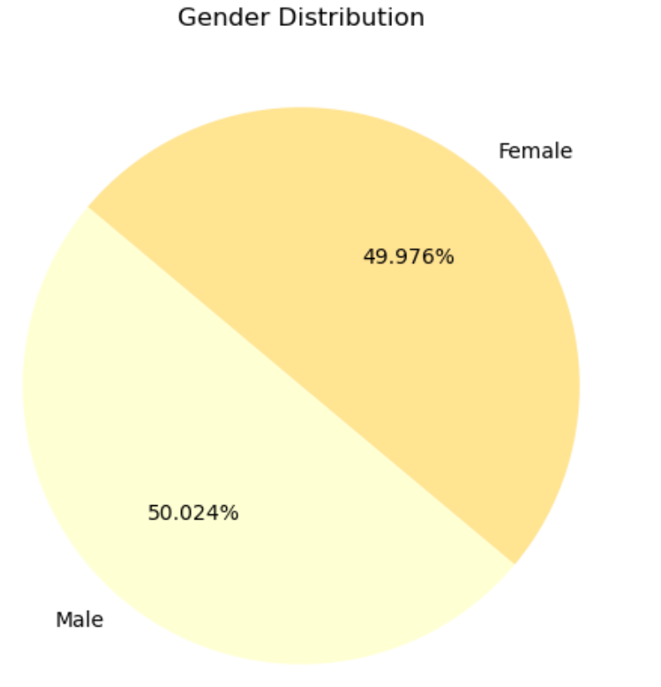
Comprehensive Exploratory Data Analysis of Healthcare Data
Key Insights:
Dataset is from 2019 to 2024 over 5 years of Data.
The dataset initially contained 55,500 rows and 16 columns, with 534 duplicate entries removed, resulting in 54,966 unique entries.
Patients' ages range from 13 to 89 years, with a nearly equal gender distribution of 50.02% male and 49.97% female.
“A-” being the most common blood type with 6,898 occurrences.
Admission types are balanced with “elective” admissions at 33.6% (18,473 cases), “emergency” admissions at 32.9% (18,102 cases), and a significant number of “urgent” admissions.
“Cigna” is the most frequent insurance provider (11,139 patients), while “Aetna” has the least (10,822 patients).
Billing amounts vary widely from -$2,008.49 to $52,764.28, with an average billing amount of $25,539.32.
Notes:
The dataset spans from 2019 to 2024, covering five years of data. Initially, it had 55,500 rows and 16 columns. After removing 534 duplicates, we have 54,966 unique entries.
Patients' ages range from 13 to 89 years, with a nearly equal gender distribution of 50.02% male and 49.97% female. The most common blood type is A-, with 6,898 occurrences.
Admission types are fairly balanced: elective admissions are 33.6% (18,473 cases), emergency admissions are 32.9% (18,102 cases), and there are significant urgent admissions.
The most frequent insurance provider is Cigna with 11,139 patients, while Aetna is the least frequent with 10,822 patients.
Billing amounts range widely from -$2,008.49 to $52,764.28, with an average billing amount of $25,539.32.
This overview provides a clear understanding of the data's scope and the variables involved in the analysis."

Slide 6
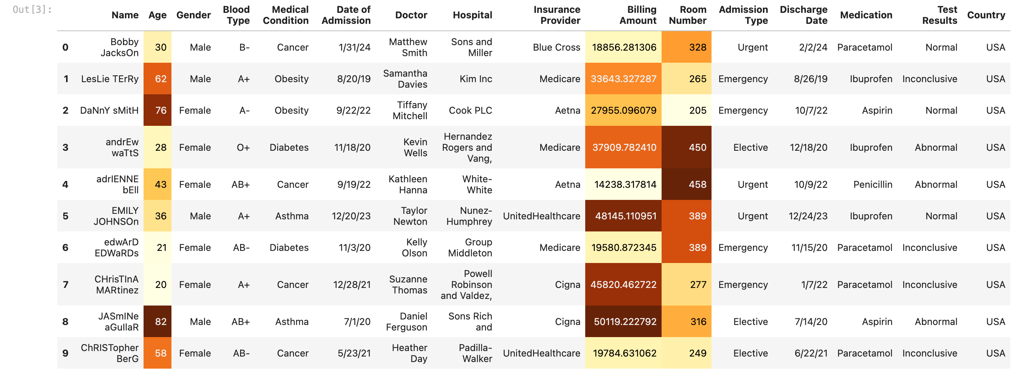
Data Cleaning Process
Initially, there were 534 duplicate entries, which were removed, leaving 54,966 unique entries.
Data cleaning improved the quality and reliability of the dataset for further analysis.
The dataset contained no missing values.
After Data Cleaning:
Notes:
Data cleaning is a crucial step in my analysis. I started with an initial dataset of 55,500 rows and 16 columns. During the cleaning process, I identified and removed 534 duplicate entries, leaving me with 54,966 unique entries. It's important to note that my dataset contained no missing values, which is quite rare and very beneficial for the analysis. Cleaning the data ensures that my analysis is based on accurate and reliable information, leading to more valid and actionable insights.

Slide 7
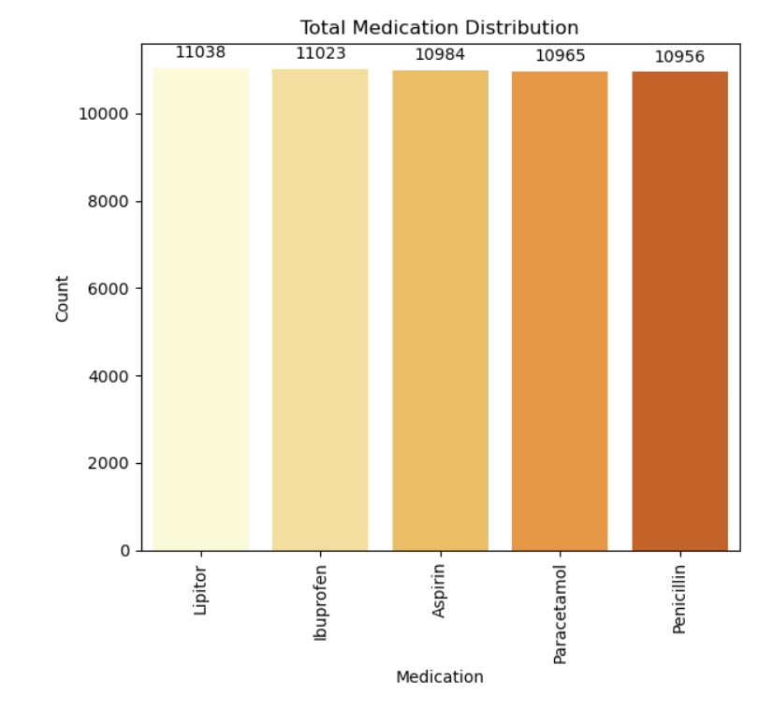
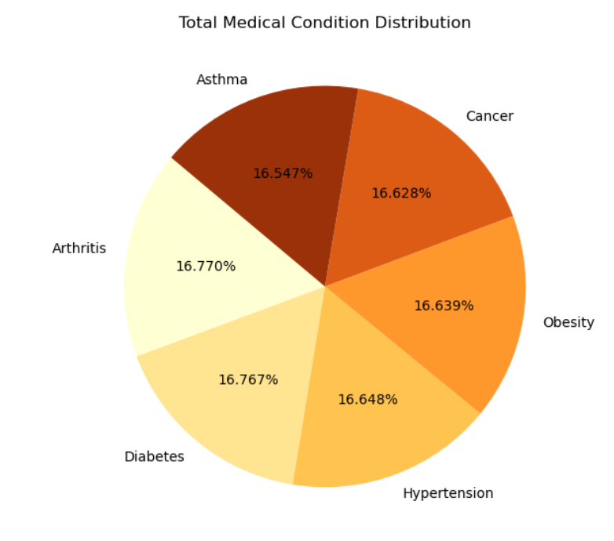
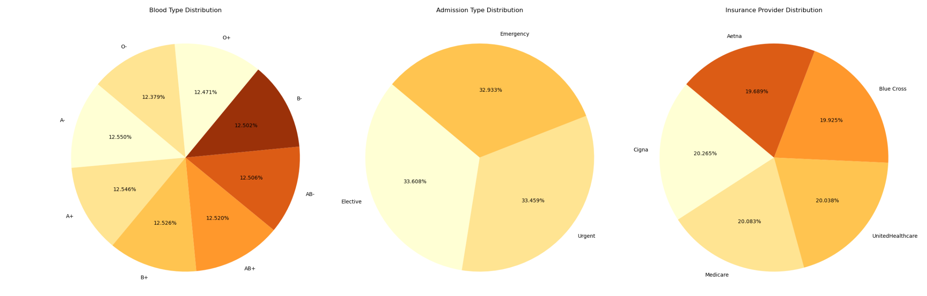
Medical and Insurance Data Analysis
After cleaning, there were 27,496 males and 27,470 females, with “A-” which accounts for 6898 occurrences.
“Arthritis” is the most prevalent medical condition, while “Lipitor” is the most commonly used medication.
“Elective” admissions are the most common, followed by “emergency” and “urgent” admissions
Notes:
This slide presents the results of my medical and insurance data analysis.
The gender distribution in my dataset is almost equal, with 50.02% male and 49.97% female.
The most common blood type is A-, as the most common blood type.
Lipitoris is the most commonly prescribed medication, with 11,038 prescriptions.
When I look at admission types, elective admissions are the most common at 33.6%, followed closely by emergency admissions at 32.9%, and urgent admissions making up the remainder. These insights help me understand the demographic and medical profile of the patients in my dataset.

Slide 8
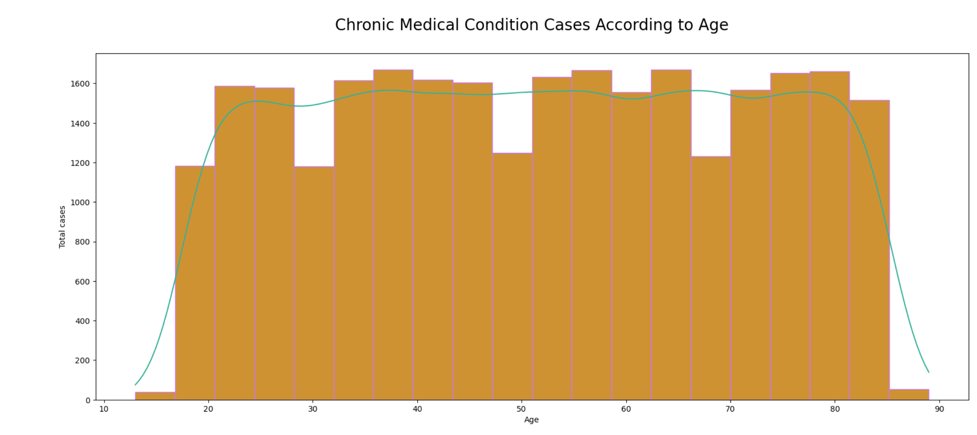
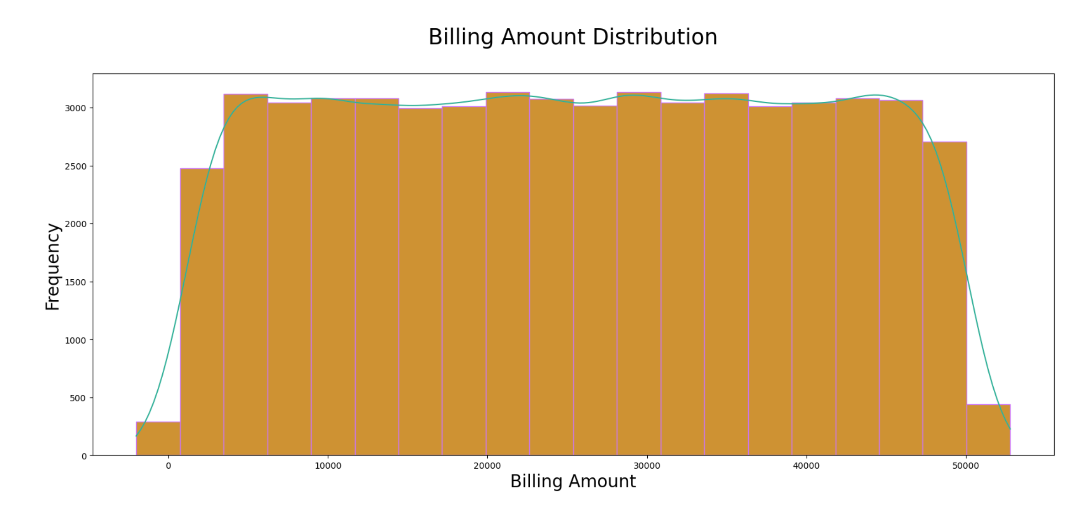
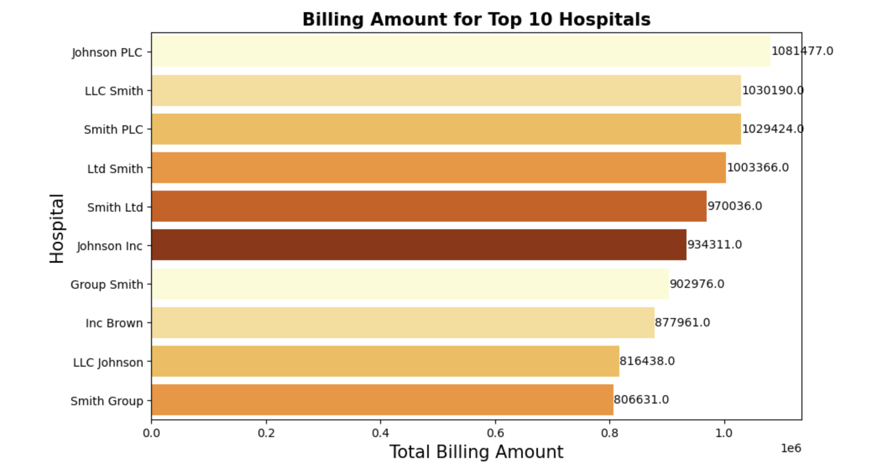
Trend Analysis
Billing amount variability: -$2008.49 to $52,764.28.
Average billing amount: $25,539.32.
Top 10 hospitals by billing amount.
Chronic conditions patterns by age.
Notes:
Next, I analyzed billing amounts and chronic conditions.
I observed significant variability in billing amounts, ranging from -$2008.49 to $52,764.28, with an average billing amount of $25,539.32. This variability indicates differences in treatment costs, possibly due to the severity of conditions or healthcare facility pricing.
I also identified the top 10 hospitals by billing amount, highlighting where the highest costs are incurred.
Additionally, I looked at patterns of chronic conditions across different age groups, which helps in understanding which age groups are more affected by specific chronic conditions and how this impacts healthcare costs and resource allocation.

Slide 9
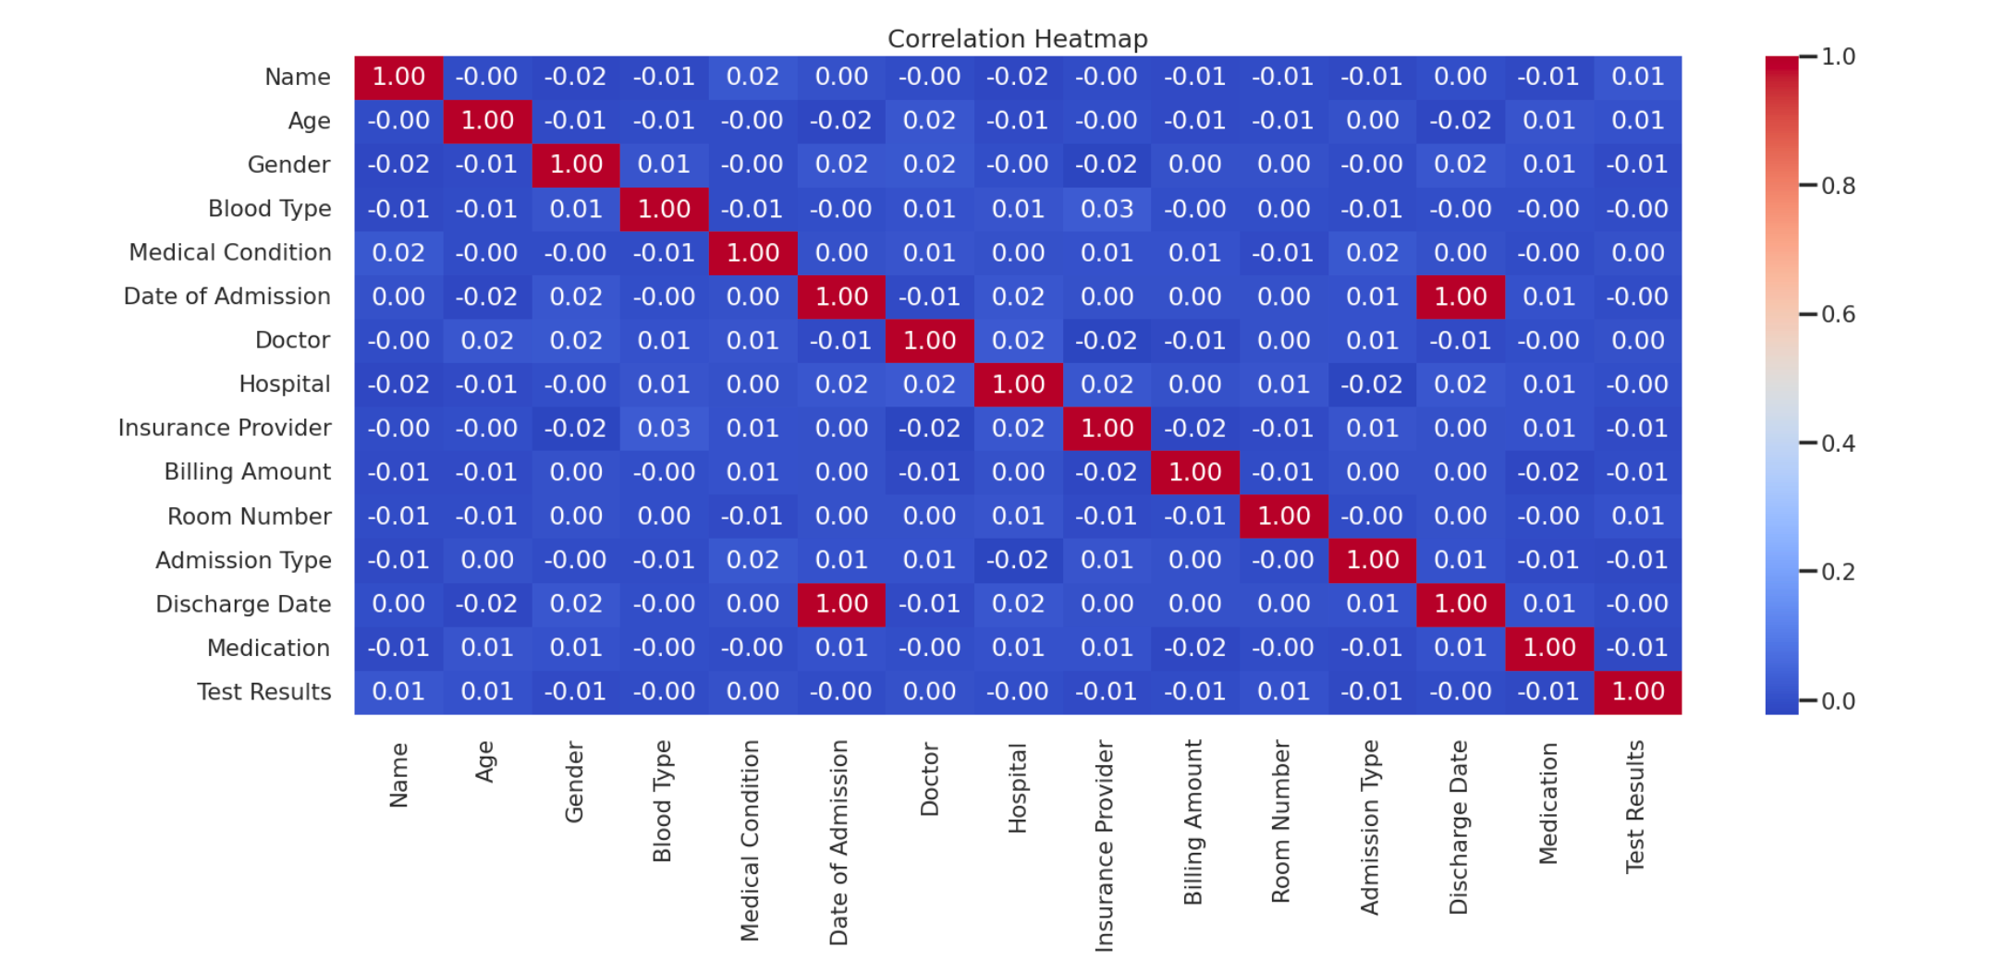
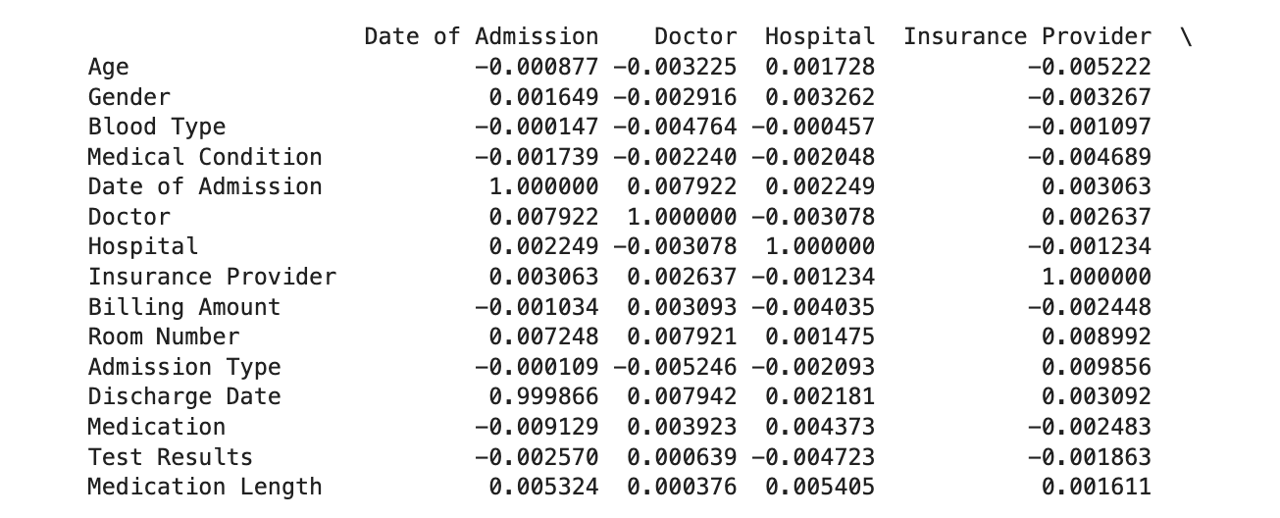
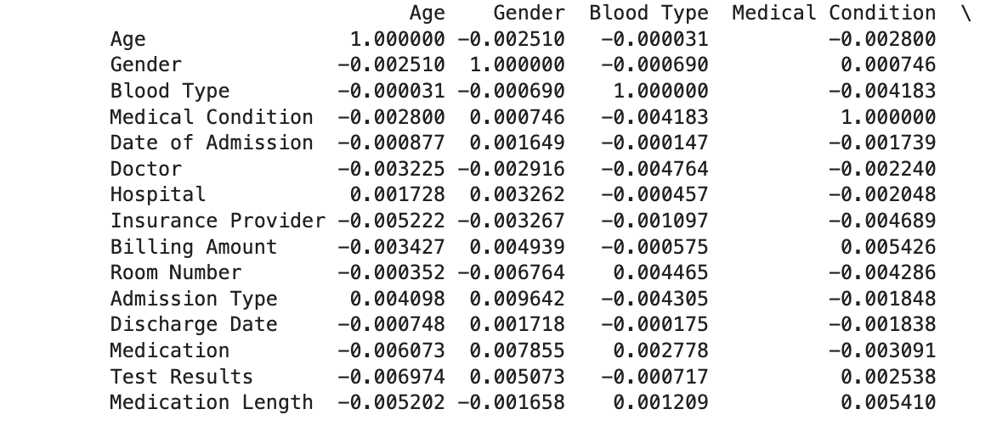
Correlation Analysis
The correlation heatmap reveals relationships between various medical conditions and other factors.

Slide 10
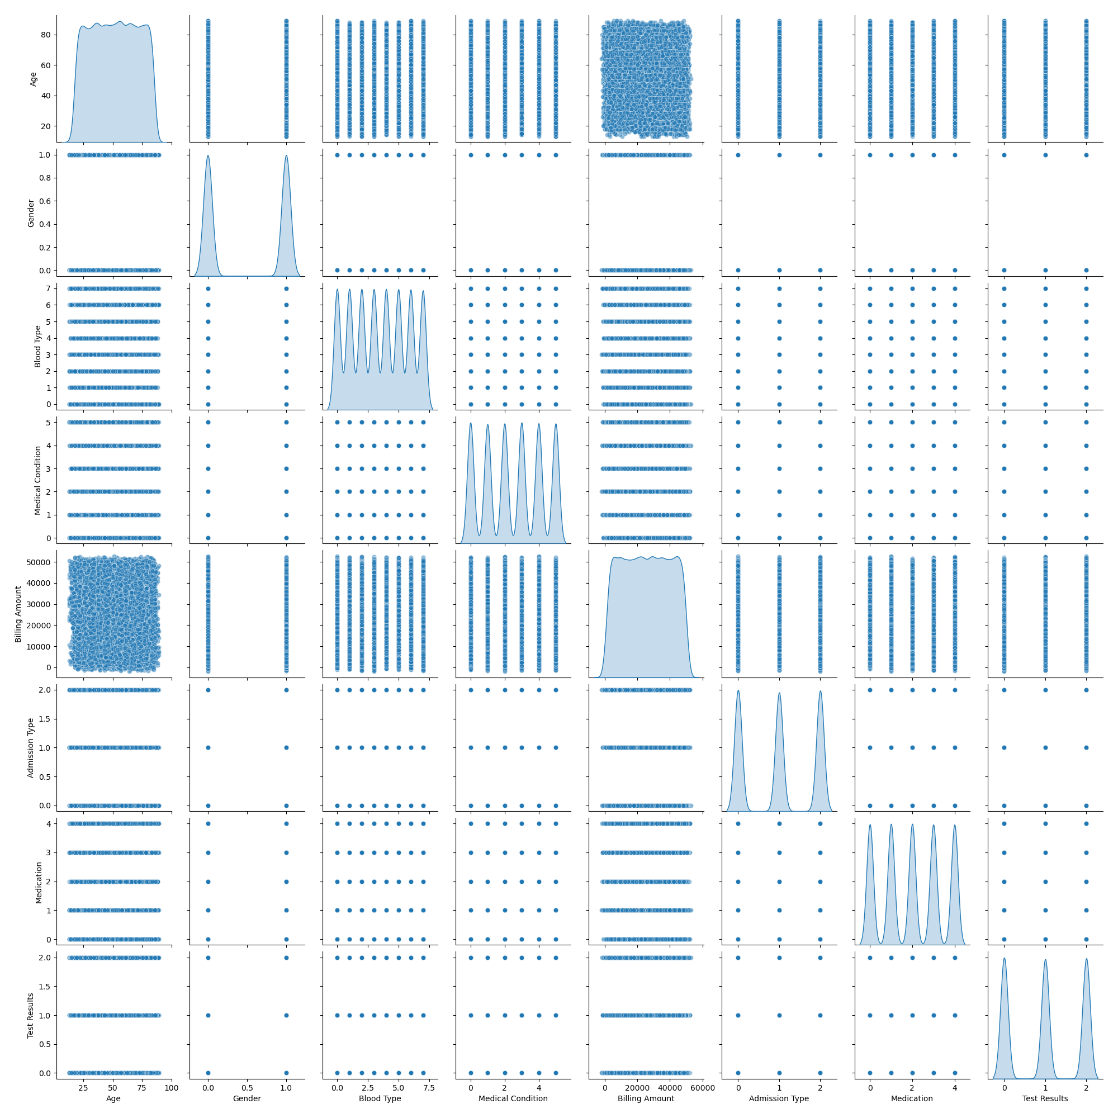
Pair Plot Analysis
Pair plot showing relationships between variables such as age, gender, medical conditions, and billing amount.
Explanation of the plot:
Diagonal plots show the distribution of each variable.
Off-diagonal plots show scatter plots of variable pairs.
Notes:
This slide features a pair plot, a powerful tool for visualizing the relationships between multiple variables.
The diagonal plots show the distribution of each variable using KDE plots. For instance, the age distribution plot shows how ages are spread across the dataset.
The off-diagonal plots are scatter plots that illustrate relationships between pairs of variables. For example, we can see how age correlates with billing amount, or how different medical conditions are distributed across genders.
By examining these plots, I can identify potential correlations and patterns that warrant further investigation.

Slide 11

Conclusion
Valuable insights into patient demographics, medical conditions, and medication usage.
Trends in billing and admission types.
Data-driven recommendations for healthcare policy improvements and resource optimization.
Notes:
In conclusion, my analysis provided valuable insights into patient demographics, medical conditions, and medication usage. I observed significant trends in billing amounts and admission types, which have important implications for healthcare delivery.
Based on these findings, I can make data-driven recommendations for healthcare policy improvements and resource optimization. For example, targeting resource allocation to regions with higher chronic condition prevalence or optimizing medication distribution based on usage patterns. These recommendations aim to improve overall healthcare outcomes and efficiency.

Slide 12

Future Scope
Further analysis of specific medical conditions.
Regional comparisons and impact analysis.
Integration of additional datasets for comprehensive analysis.
Continuous monitoring and policy adjustment recommendations.
Notes:
Looking ahead, there are several areas for future research:
I can conduct a deeper analysis of specific medical conditions to understand their impact in greater detail.
Comparing healthcare outcomes and resource utilization across different regions will provide a clearer picture of regional disparities.
Integrating additional datasets, such as socioeconomic or environmental data, will enable a more comprehensive analysis.
Continuous monitoring and policy adjustments based on real-time data can help maintain optimal healthcare delivery and address emerging health issues promptly.

Slide 13
References
Data Sources:
Kaggle: Healthcare Dataset
Research Papers:
The Northridge Group. (n.d.). Impact of Big Data on Health Care.
USC Sol Price School of Public Policy. (2023, November 17). How Health Care Data Analytics Improves Quality of Care.
St. Bonaventure University. (2021, June 21). How Business Analytics Is Changing the Healthcare Industry.
Abbott. (n.d.). The Impact of Big Data in Healthcare.
Southern Methodist University. (2023, June). The Future of Data Analytics in the Healthcare.
Pedregosa, F., Varoquaux, G., Gramfort, A., Michel, V., Thirion, B., Grisel, O., ... & Vanderplas, J. (2011). "Scikit-learn: Machine Learning in Python." Journal of Machine Learning Research, 12(Oct), 2825-2830.
TensorFlow. (2024). "TensorFlow: An end-to-end open-source machine learning platform."
Keras. (2024). "Keras: The Python Deep Learning library."

Slide 14


Email: janapaga@mail.uc.edu
LinkedIn: https://www.linkedin.com/in/geetha-janapareddi/
Role: Masters in Business Analytics with Data Science Specialization
Geetha Janapareddi
Notes:
special thanks to second reader - Dr. Lin Zewei - Graduate Assistant Professor who helped me in analysis and finding results. I would like to add appendix with reference documents and my all finds future.

Slide 15
Appendix

Slide 16
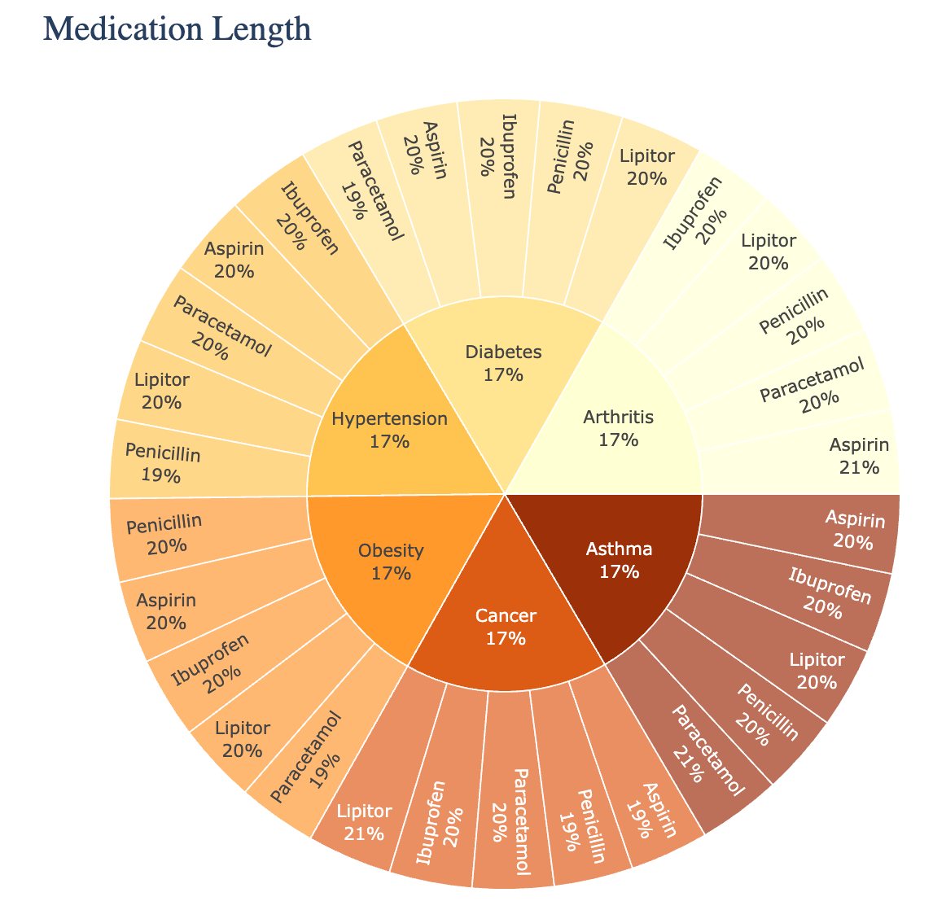
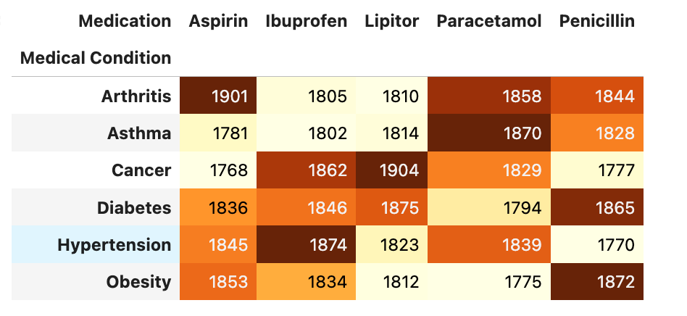
Medication Details

Slide 17
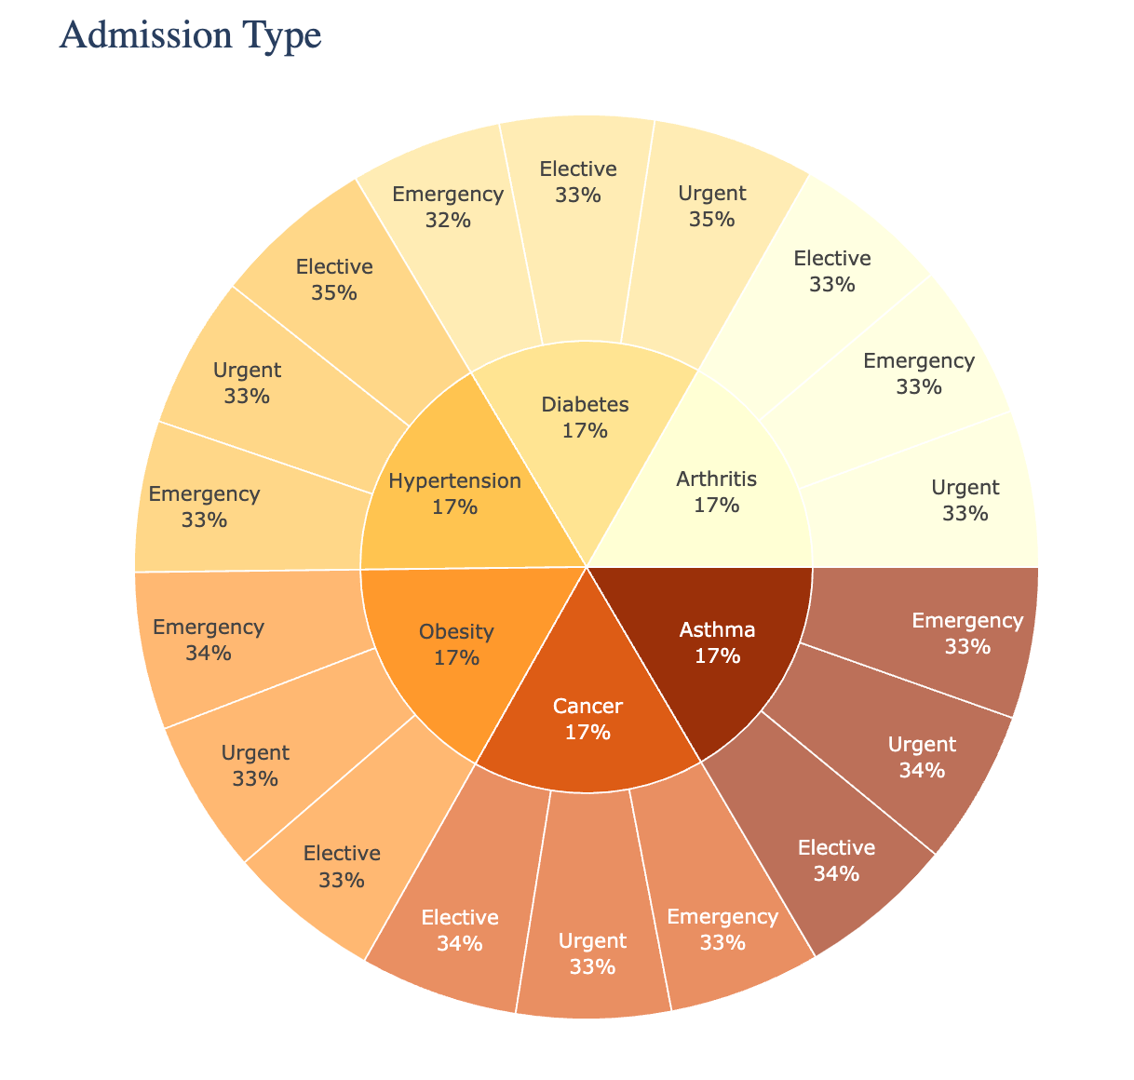
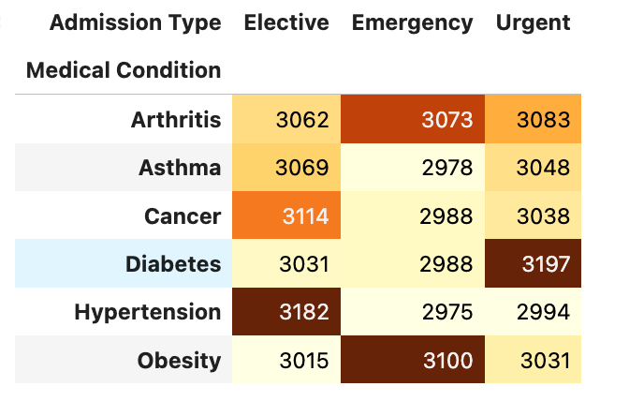
Admission Details

Slide 18
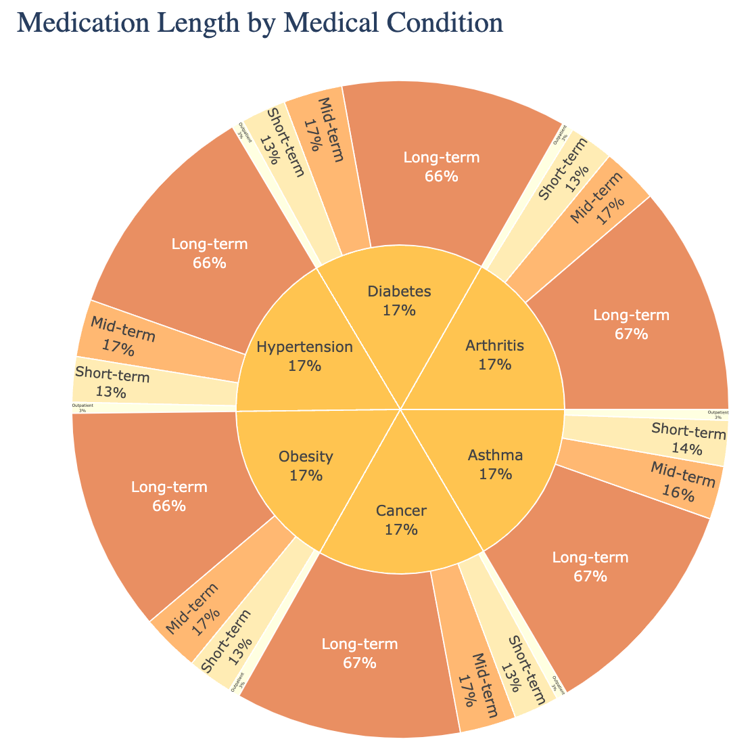
Medical Length

